Slide 1
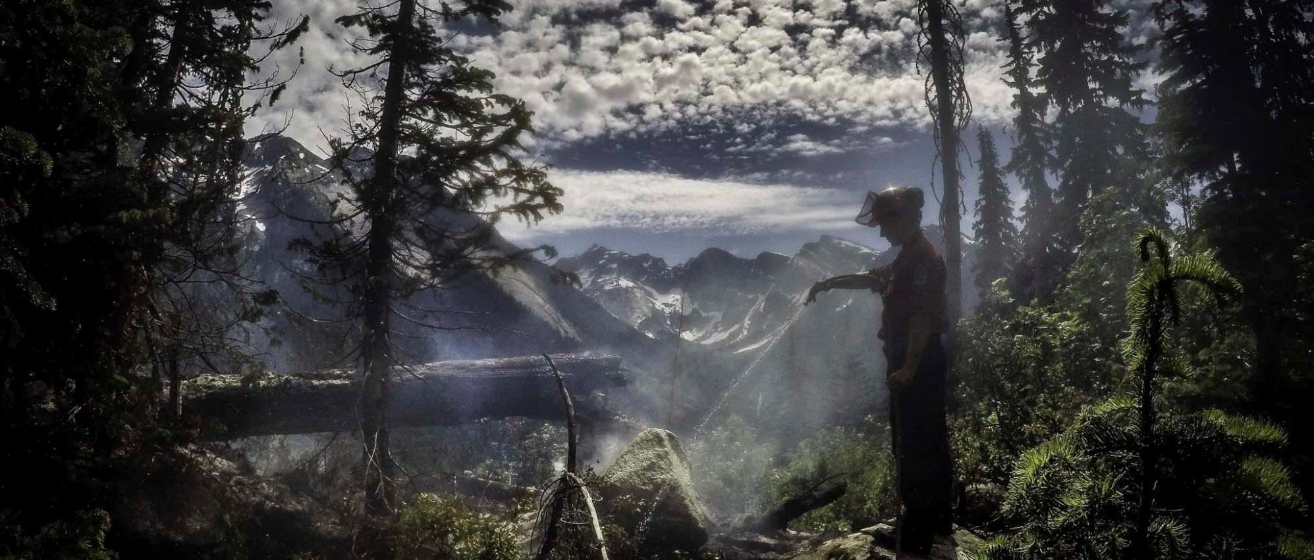
2018 review, 2019 looking forward
BC Wildfire Service | April 5th, 2019

Slide 2
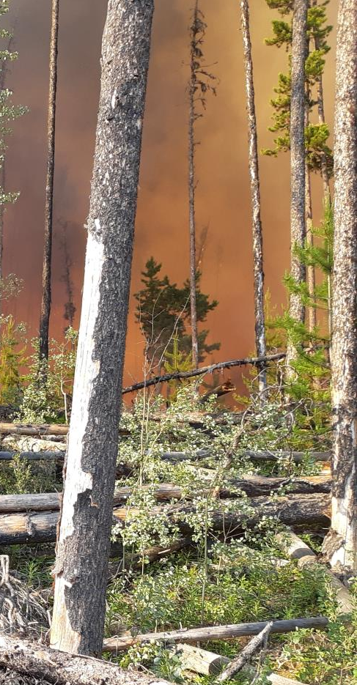
Provincial Statistics: 2017 & 2018
 | 2017 Fire Season | 2018 Fire Season
Total fires | 1,353 | 2,087
Lightning-caused fires* | 773 (about 57.1%) | 1,536 (about 73.5%)
Human-caused wildfires* | 552 (about 40.8%) | 524 (about 25.1%)
Area burned | 1,216,053 ha | 1,349,603 ha
Fires of Note | 70 | 111
Evacuation Orders | 120 | 66
# of properties evacuated | 18,737 | 2,211
Evacuation Alerts | 166 | 124
# of properties on alert | 10,656 | 17,939
Suppression Costs | ~ $649.6 million | ~ $554.5 million
Total Days on Provincial State of Emergency | 71 days (Jul 7 to Sep 15) | 24 days (Aug 15 to Sep 7)
Notes:
Key Info on this slide:
75% Lightning caused fires – not seeing more lightning events, seeing more starts that are more volatile because of conditions on the ground (drought and fuel load)
Areas burned last 2 years – fuel load and drought, significant fire behaviour lead to suppression challenges – lots of hectares impacted
Proximity to communities
Suppression costs – need to be spending more on prevention and fuel mitigation to lessen the risk and behaviour which will see less suppression challenges and costs.

Slide 3
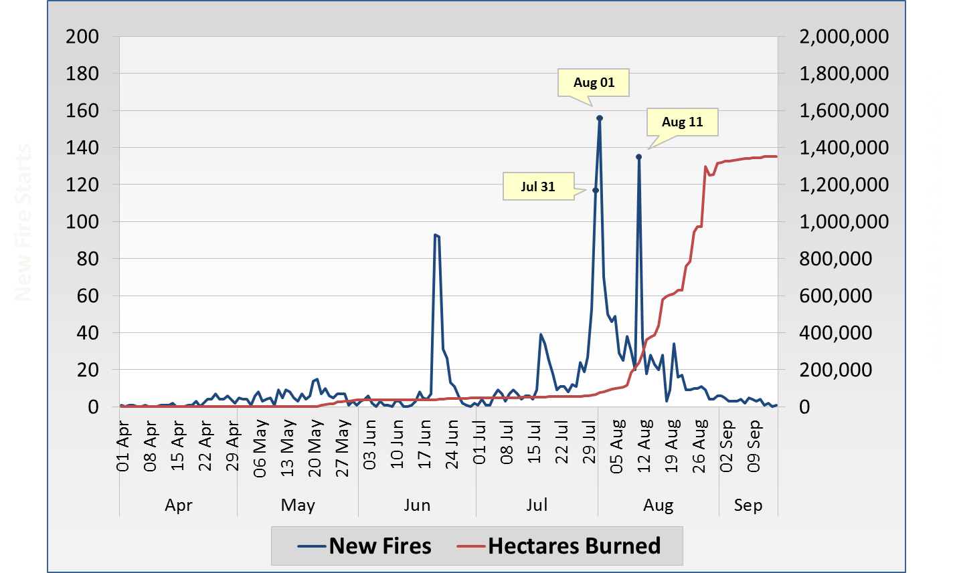
New Fires and Area Burned (2018)
High temperatures (record-breaking in some cases) were observed in late July.
Then, over 70,000 lightning strikes were recorded between July 31 and August 1, 2018 according to Environment Canada.
Notes:
This chart chronologically displays how many new wildfires started each day in 2018, as well as how many hectares had cumulatively burned since April1.
The new fire starts data was pulled from Whiteboard, based on the discovery date logged for each fire incident.
The hectares burned data comes from two sources. Up until the end of August, it was being sourced from the SITREP application accessed through Citrix Receiver. At the end of August, BCWS Geospatial Services began running daily reports of the total area burned to provide more accurate estimates, so I switched to that report’s data for August 31 onwards.
As you may notice as well, there is a slight “dip” in the hectares burned illustrated at the end of August. It’s technically not possible for this number to trend downward (fire perimeters do not shrink), so this “dip” is only indicative of remapping of some of our existing fires. (This data represents what we knew to be true as of a certain day – it hasn’t nessesarily been adjusted retroactively to correct over-reported values.)
The stat about the lightning strikes comes from Environment Canada:
https://twitter.com/ECCCWeatherBC/status/1024683051731873798
https://twitter.com/ECCCWeatherBC/status/1025035951536525313

Slide 4
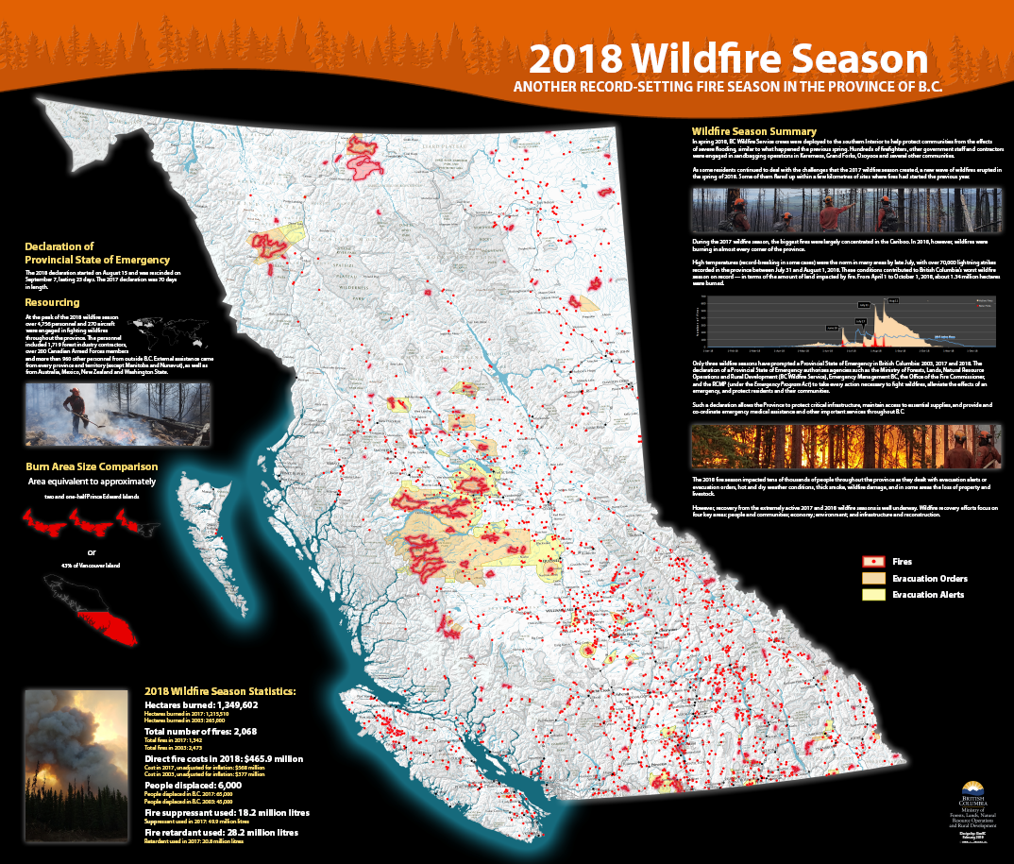

Slide 5
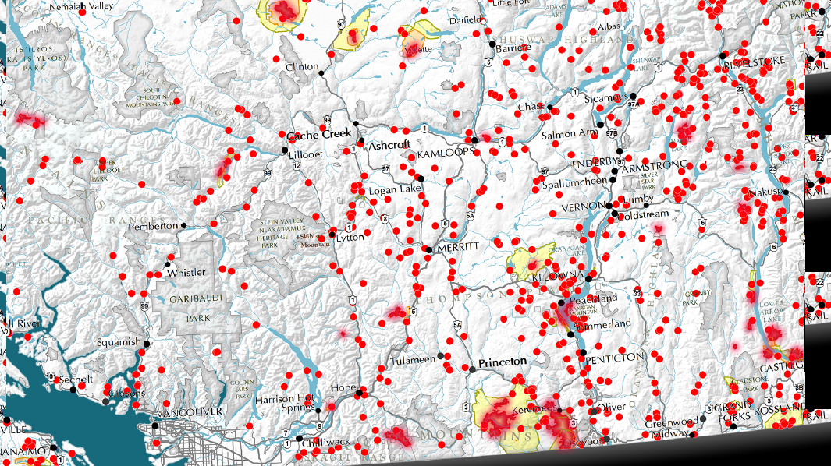
Kamloops Wildfires 2018

Slide 6
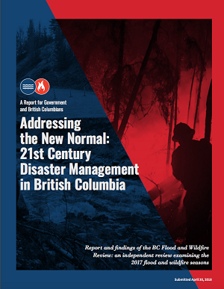
Addressing the New Normal – Abbott/Chapman
THEMES:
Preparedness and Planning (56)
Prevention and Mitigation (25)
Recovery (17)
Response (10)
STATUS:
Recommendation Summary (Oct 31 report):
  19 complete
  16 further analysis
  73 underway
  44% FLNR
  30% EMBC
Notes:
May 2018 report released – the report combined with the 2018 and 2017 seasons are catalysts to many of the changes
Both flood and fire recommendations
Governments action plan followed in October 2018
Next public report April 2019
Executive Lead jointly reporting to EMBC and BCWS coordinating response and reporting to Premiers Office
Cross government groups working together to action the recommendations
Themes highlight the importance of prepardeness and prevention - 75% of the recommendations
Many initiated in 2018 season and deemed complete or underway
Some require legislative or policy changes to fully implement and also involve the federal government – these make up the 16 as further analysis

Slide 7
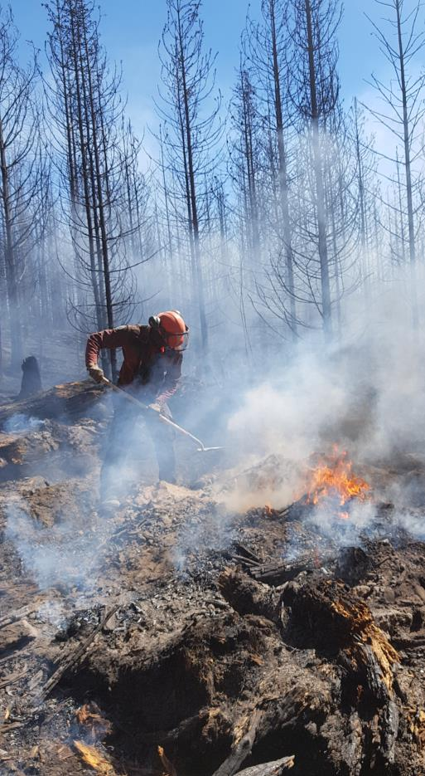
Key BC Wildfire Service Forward Strategies
Improved engagement with First Nations
Improved Stakeholder & Industry Engagement
Procurement of Type 2 Contract Crews
Formalising Joint Hazard Management Teams approach
Increased focus on prevention
Research and Innovation
Improved Social Media Strategy
Additional Communications Staff at Fire Centres and Provincial Wildfire Coordination Centre
Enhanced information sharing protocols with EMBC, and hiring of consultants
Enhanced Interactive Wildfire Map
Notes:
overall, BCWS is shifting how we operate, how we are structured, priorities of the organization
Been shifting from a ‘response’ organization to a 12 month of the year organization focused on 4 phases of EM – prepardness, prevention, response and recovery
Overarching shift in need for stronger partnerships with First Nations and Stakeholders – Director of Strategic Engagement position created to build a strategy for BCWS and to support centres and zones with local engagement. Also focusing on strategic provincial partnerships. Need to partner with you all as professionals to improve how we are managing the landscape to build resilience into our forests and communities.
Engaged liaisons with IMT’s and operations, daily community meetings, pre-season meetings and post season de-briefs. Lower Similk, Fraser Lake communities, cattlemens and licencees.

Slide 8
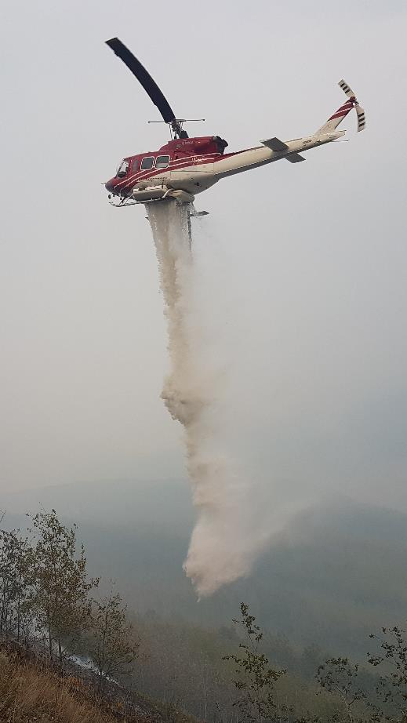
Wildfire Rehabilitation – Why?
Associate Deputy Minister decision fall 2018
Recognition:
  Expertise falls within Engineering staff
  Rehab is a government obligation
  Land Manager (District Manager) is responsible for activities on the land base
  Previously utilized TEAMS process but these staff already report to Land Manager

Slide 9
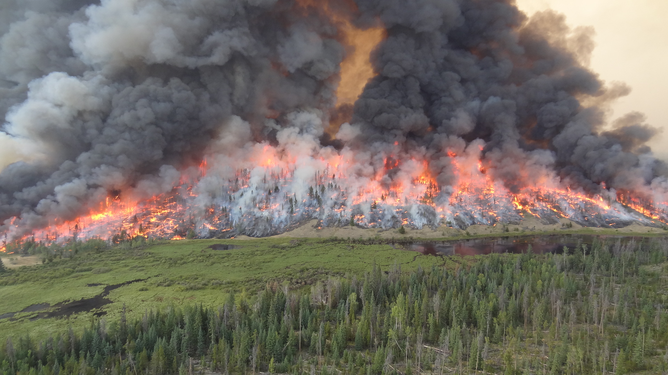
Wildfire Rehabilitation -- Challenges
Communication
Consistency
Resourcing
Learning Series
Transition Project

Slide 10
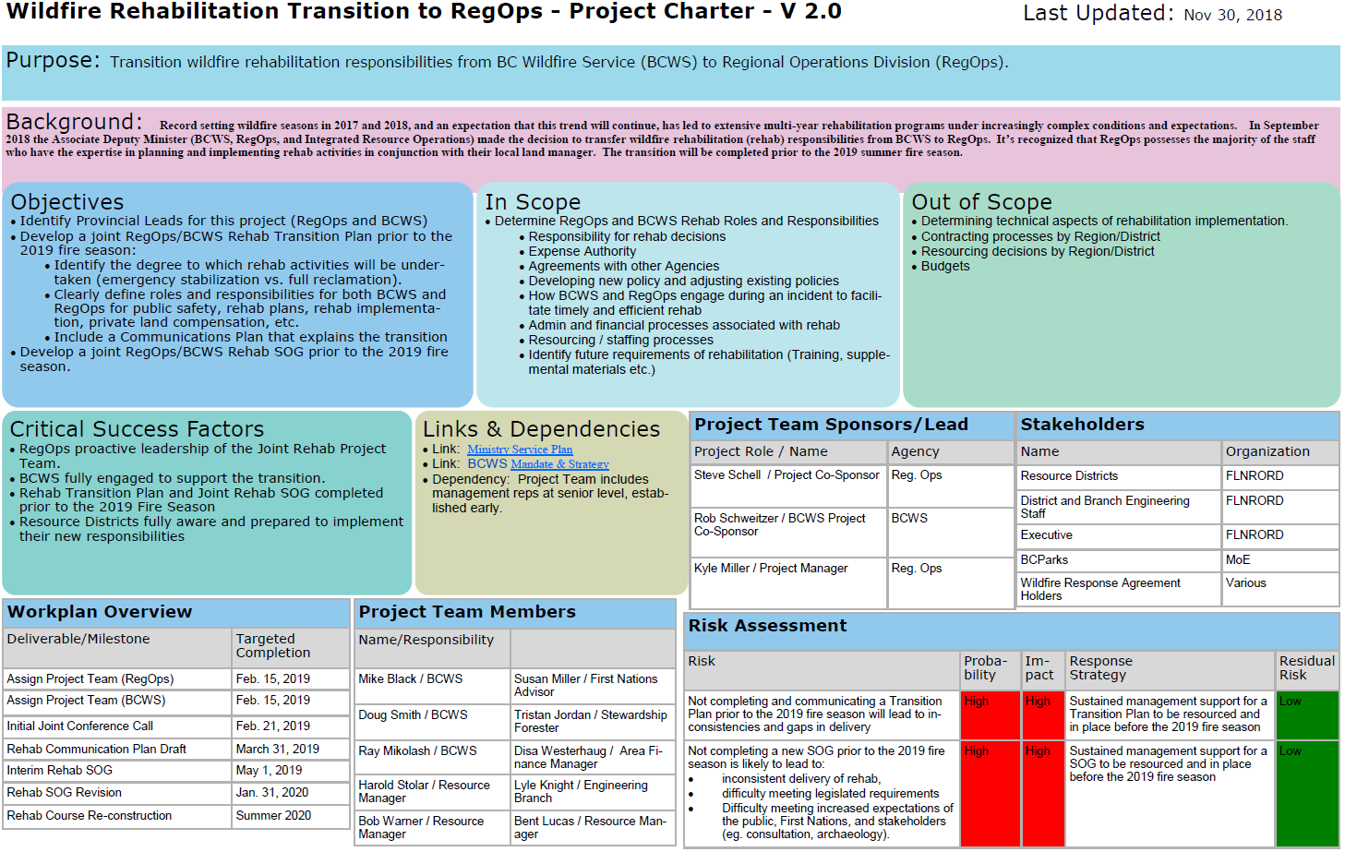

Slide 11

Questions?

